Slide 1
Chapter 7: Virtual Memory & Mass Storage

Slide 2
Background
Code needs to be in memory to execute, but entire program rarely used
Error code, unusual routines, large data structures
Entire program code not needed at same time
Consider ability to execute partially-loaded program
Program no longer constrained by limits of physical memory
Each program takes less memory while running -> more programs run at the same time
Increased CPU utilization and throughput with no increase in response time or turnaround time
Less I/O needed to load or swap programs into memory -> each user program runs faster

Slide 3
Virtual memory
Virtual memory – separation of user logical memory from physical memory
Only part of the program needs to be in memory for execution
Logical address space can therefore be much larger than physical address space
Allows for more efficient process creation
More programs running concurrently
Less I/O needed to load or swap processes

Slide 4
Virtual memory (Cont.)
Virtual address space – logical view of how process is stored in memory
Usually start at address 0, contiguous addresses until end of space
Meanwhile, physical memory organized in page frames
MMU must map logical to physical
Virtual memory can be implemented via:
Demand paging

Slide 5
Demand Paging
Could bring entire process into memory at load time
Or bring a page into memory only when it is needed
Less I/O needed, no unnecessary I/O
Less memory needed
Faster response
More users
Page is needed ⇒ reference to it
invalid reference ⇒ abort
not-in-memory ⇒ bring to memory
Lazy swapper – never swaps a page into memory unless page will be needed

Slide 6
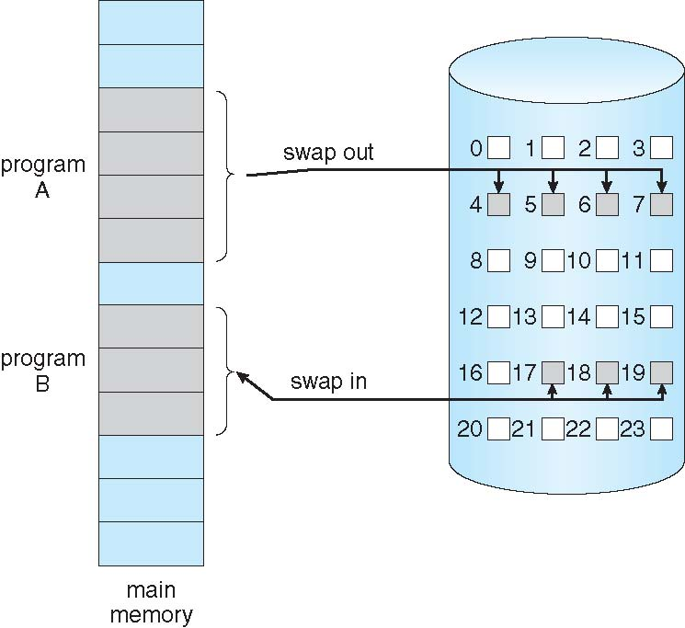
Demand Paging

Slide 7
Basic Concepts
With swapping, pager guesses which pages will be used before swapping out again
Instead, pager brings in only those pages into memory
How to determine that set of pages?
Need new MMU functionality to implement demand paging
If pages needed are already memory resident
No difference from non demand-paging
If page needed and not memory resident
Need to detect and load the page into memory from storage

Slide 8
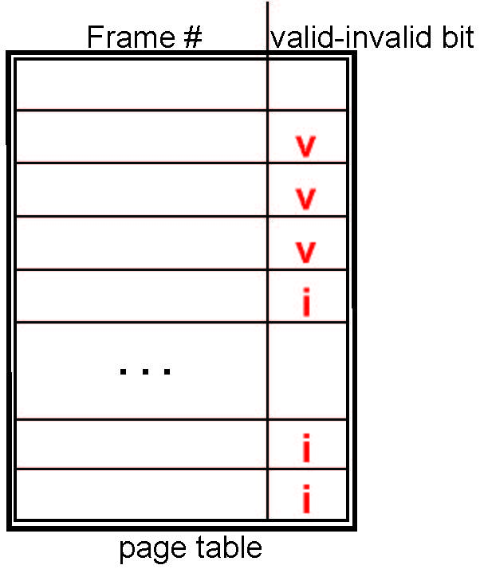
Valid-Invalid Bit
With each page table entry a valid–invalid bit is associated (v ⇒ in-memory – memory resident, i ⇒ not-in-memory)
Initially valid–invalid bit is set to i on all entries
Example of a page table snapshot:
During MMU address translation, if valid–invalid bit in page table entry is i ⇒ page fault

Slide 9
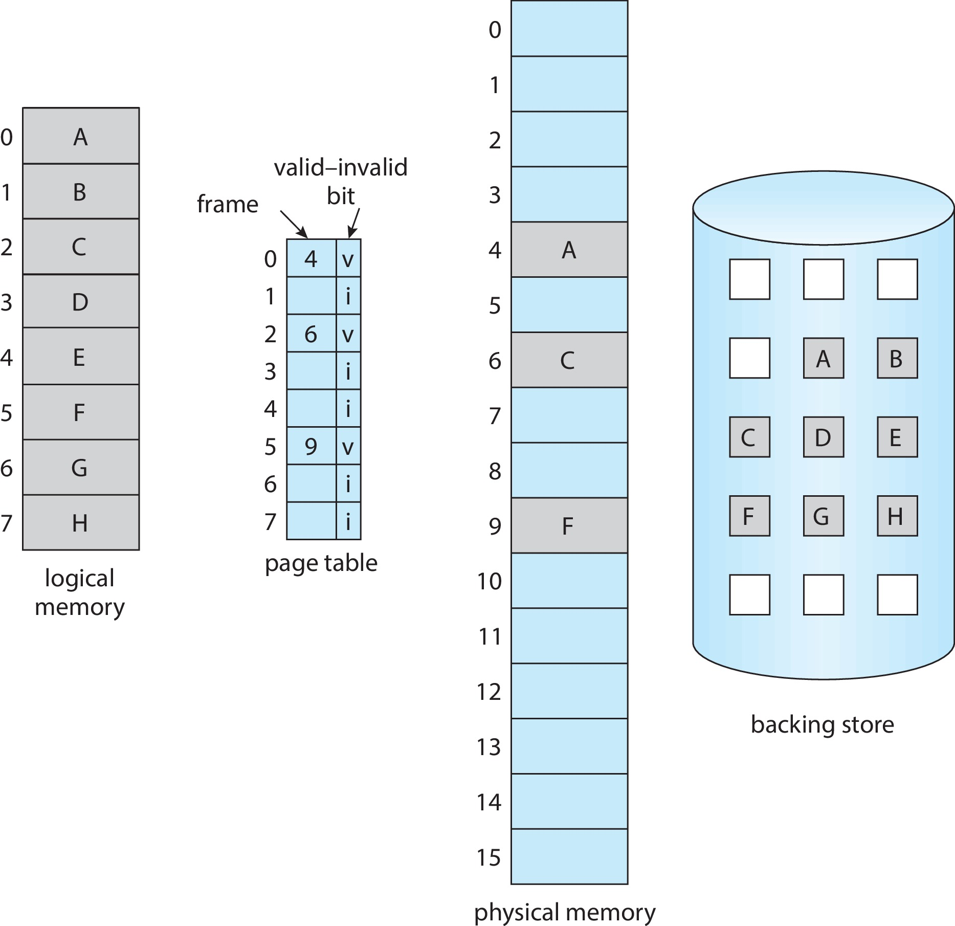
Page Table When Some Pages Are Not in Main Memory

Slide 10
Steps in Handling Page Fault
If there is a reference to a page, first reference to that page will trap to operating system
Page fault
Operating system looks at another table to decide:
Invalid reference ⇒ abort
Just not in memory
Find free frame
Swap page into frame via scheduled disk operation
Reset tables to indicate page now in memory Set validation bit = v
Restart the instruction that caused the page fault

Slide 11

Steps in Handling a Page Fault (Cont.)

Slide 12
Free-Frame List
When a page fault occurs, the operating system must bring the desired page from secondary storage into main memory.
Most operating systems maintain a free-frame list -- a pool of free frames for satisfying such requests.
When a system starts up, all available memory is placed on the free-frame list.

Slide 13
Stages in Demand Paging – Worse Case
Trap to the operating system
Save the user registers and process state
Determine that the interrupt was a page fault
Check that the page reference was legal and determine the location of the page on the disk
Issue a read from the disk to a free frame:
Wait in a queue for this device until the read request is serviced
Wait for the device seek and/or latency time
Begin the transfer of the page to a free frame

Slide 14
Stages in Demand Paging (Cont.)
While waiting, allocate the CPU to some other user
Receive an interrupt from the disk I/O subsystem (I/O completed)
Save the registers and process state for the other user
Determine that the interrupt was from the disk
Correct the page table and other tables to show page is now in memory
Wait for the CPU to be allocated to this process again
Restore the user registers, process state, and new page table, and then
resume the interrupted instruction

Slide 15
What Happens if There is no Free Frame?
Page replacement – find some page in memory, but not really in use, page it out
Algorithm – terminate? swap out? replace the page?
Performance – want an algorithm which will result in minimum number of page faults
Same page may be brought into memory several times

Slide 16
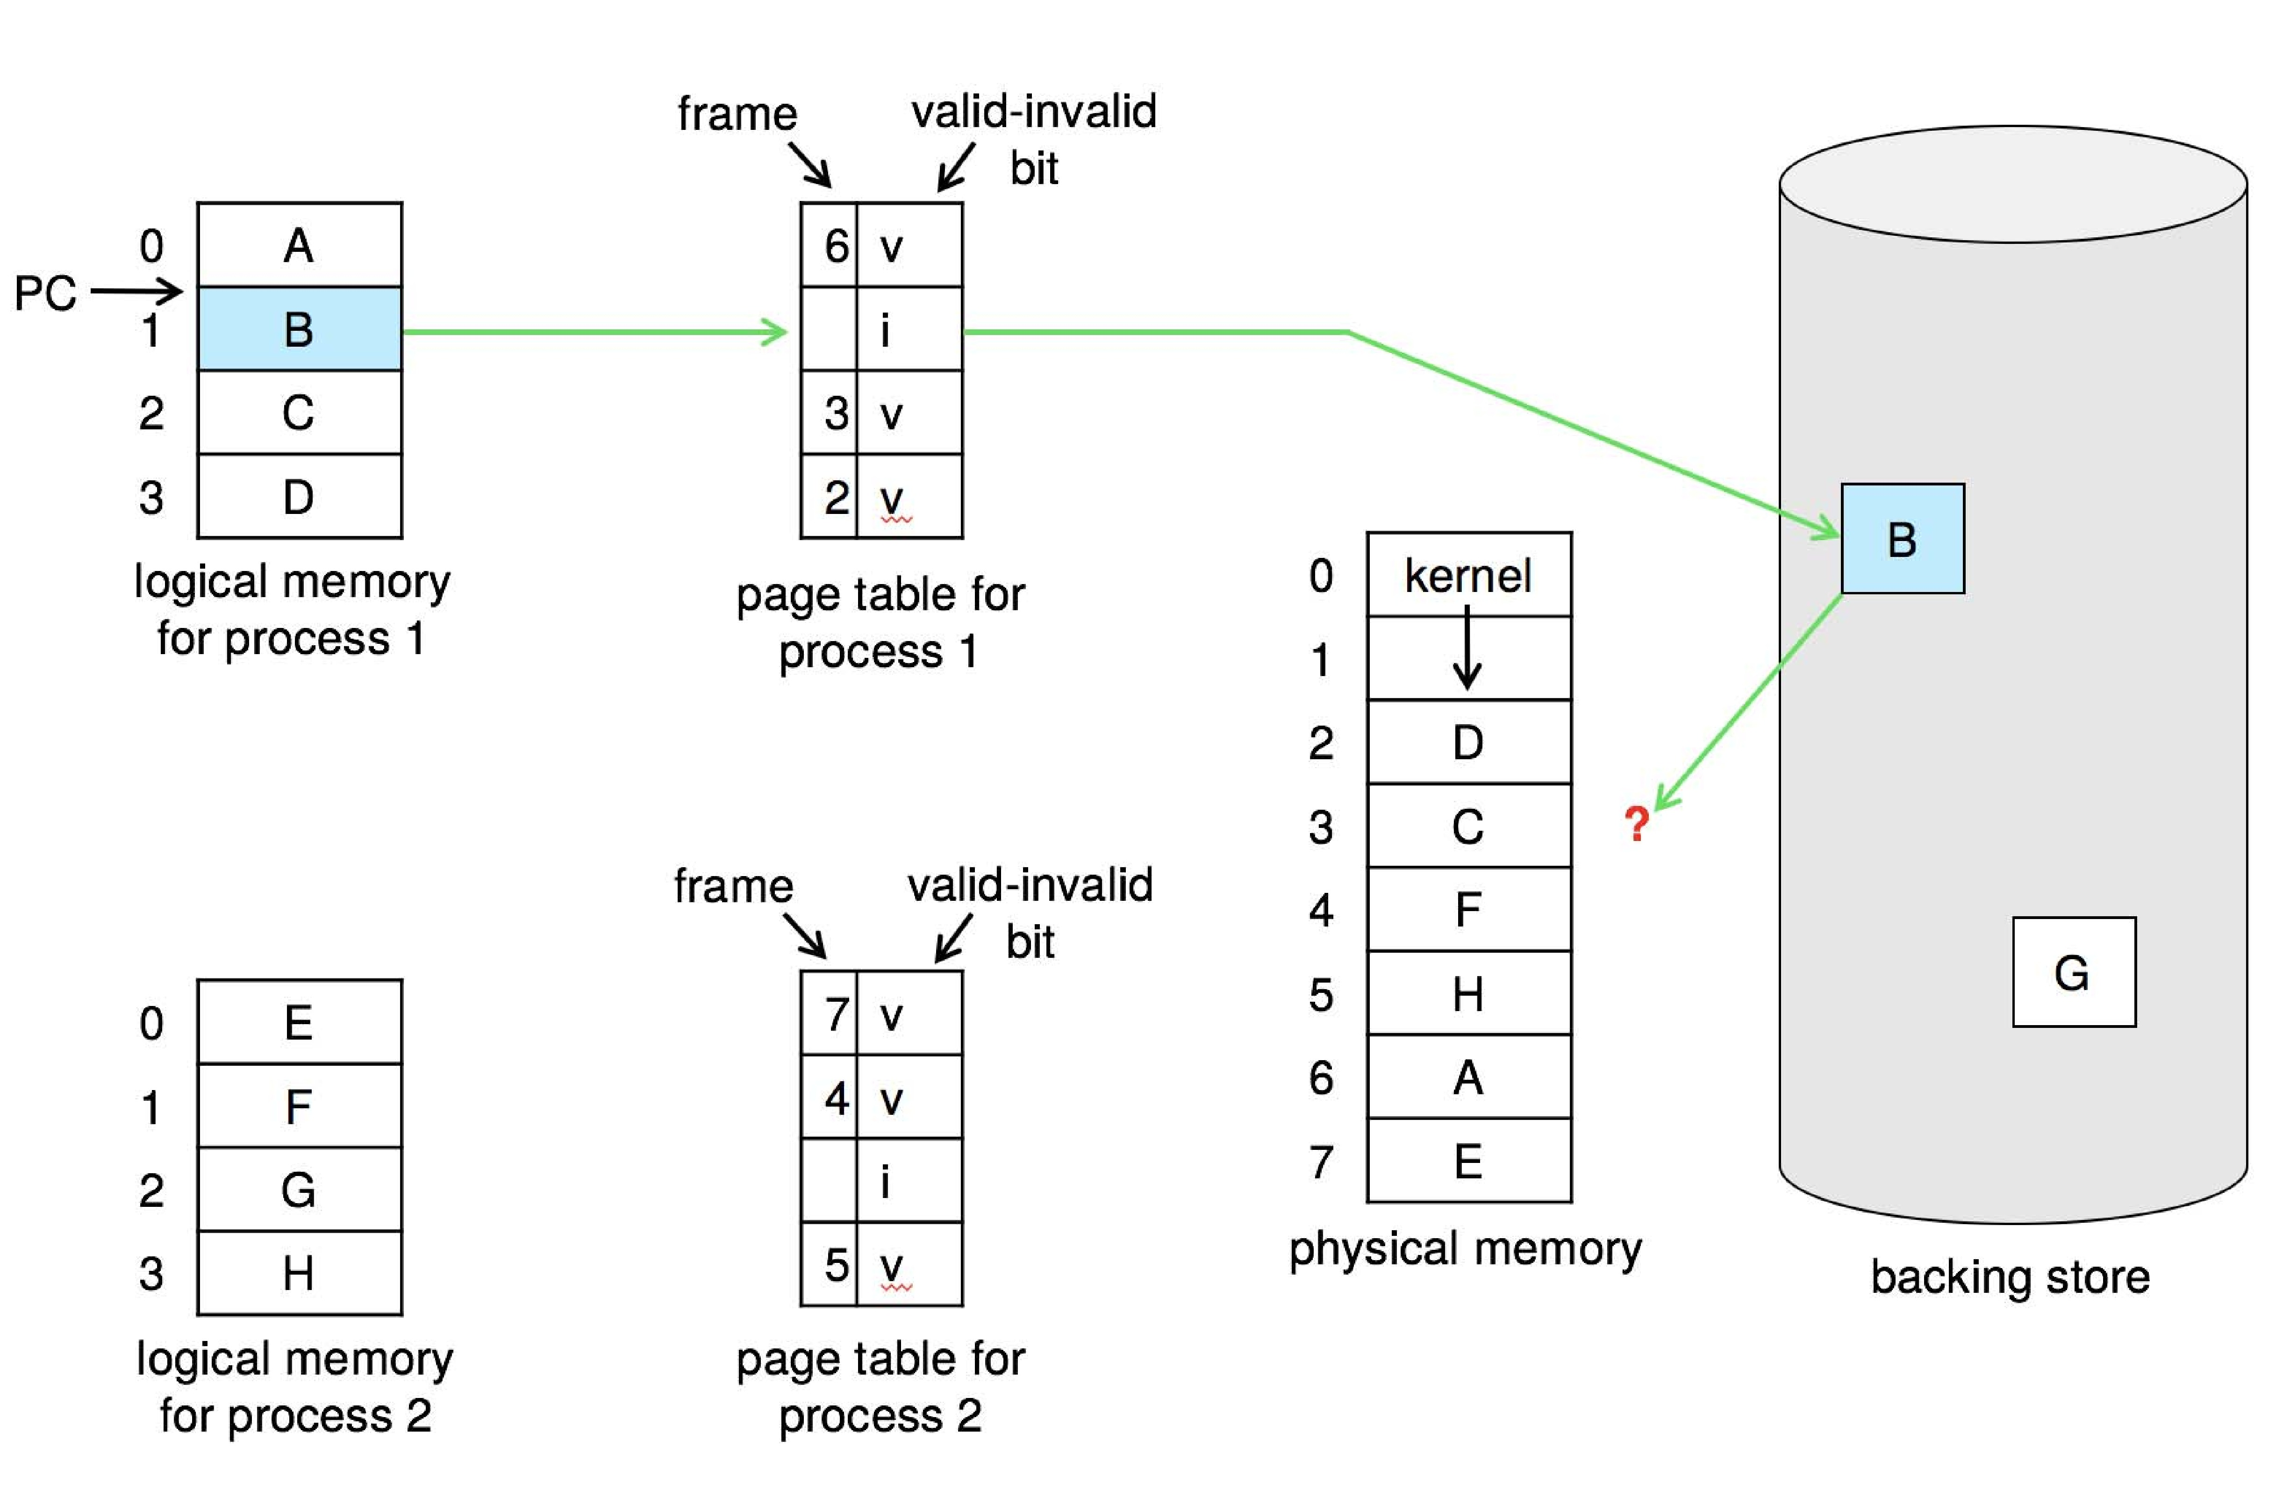
Need For Page Replacement

Slide 17
Basic Page Replacement
Find the location of the desired page on disk
Find a free frame: - If there is a free frame, use it - If there is no free frame, use a page replacement algorithm to select a victim frame - Write victim frame to disk if dirty
Bring the desired page into the (newly) free frame; update the page and frame tables
Continue the process by restarting the instruction that caused the trap

Slide 18
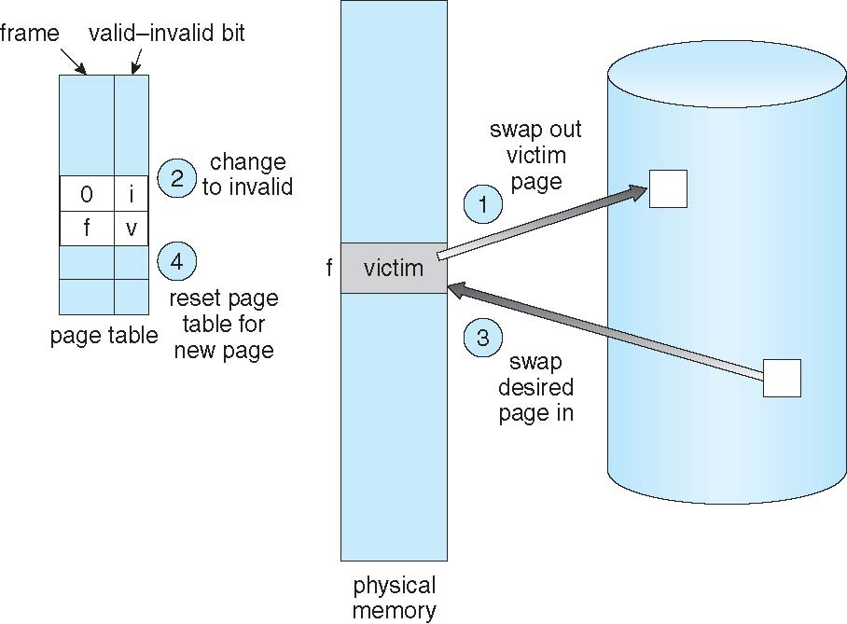
Page Replacement

Slide 19
Page and Frame Replacement Algorithms
Frame-allocation algorithm determines
How many frames to give each process
Which frames to replace
Page-replacement algorithm
Want lowest page-fault rate on both first access and re-access
Evaluate algorithm by running it on a particular string of memory references (reference string) and computing the number of page faults on that string
String is just page numbers, not full addresses
Repeated access to the same page does not cause a page fault
Results depend on number of frames available
In all our examples, the reference string of referenced page numbers is
7,0,1,2,0,3,0,4,2,3,0,3,0,3,2,1,2,0,1,7,0,1

Slide 20
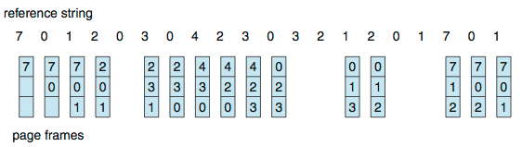
First-In-First-Out (FIFO) Algorithm
Reference string: 7,0,1,2,0,3,0,4,2,3,0,3,0,3,2,1,2,0,1,7,0,1
3 frames (3 pages can be in memory at a time per process)
Can vary by reference string: consider 1,2,3,4,1,2,5,1,2,3,4,5
Adding more frames can cause more page faults!
Belady’s Anomaly
How to track ages of pages?
Just use a FIFO queue
15 page faults

Slide 21
FIFO Illustrating Belady’s Anomaly

Slide 22
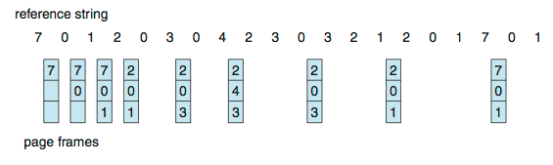
Optimal Algorithm
Replace page that will not be used for longest period of time
9 is optimal for the example
How do you know this?
Can’t read the future
Used for measuring how well your algorithm performs

Slide 23
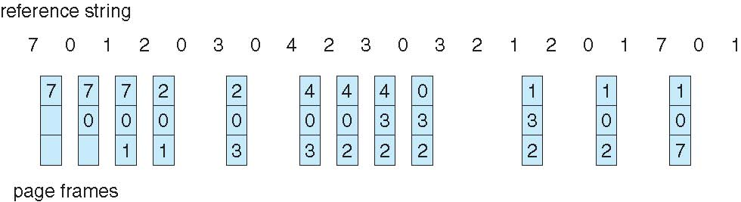
Least Recently Used (LRU) Algorithm
Use past knowledge rather than future
Replace page that has not been used in the most amount of time
Associate time of last use with each page
12 faults – better than FIFO but worse than OPT
Generally good algorithm and frequently used

Slide 24
Overview of Mass Storage Structure
Bulk of secondary storage for modern computers is hard disk drives (HDDs) and nonvolatile memory (NVM) devices
HDDs spin platters of magnetically-coated material under moving read-write heads
Drives rotate at 60 to 250 times per second
Transfer rate is rate at which data flow between drive and computer
Positioning time (random-access time) is time to move disk arm to desired cylinder (seek time) and time for desired sector to rotate under the disk head (rotational latency)
Head crash results from disk head making contact with the disk surface -- That’s bad
Disks can be removable

Slide 25
Moving-head Disk Mechanism

Slide 26
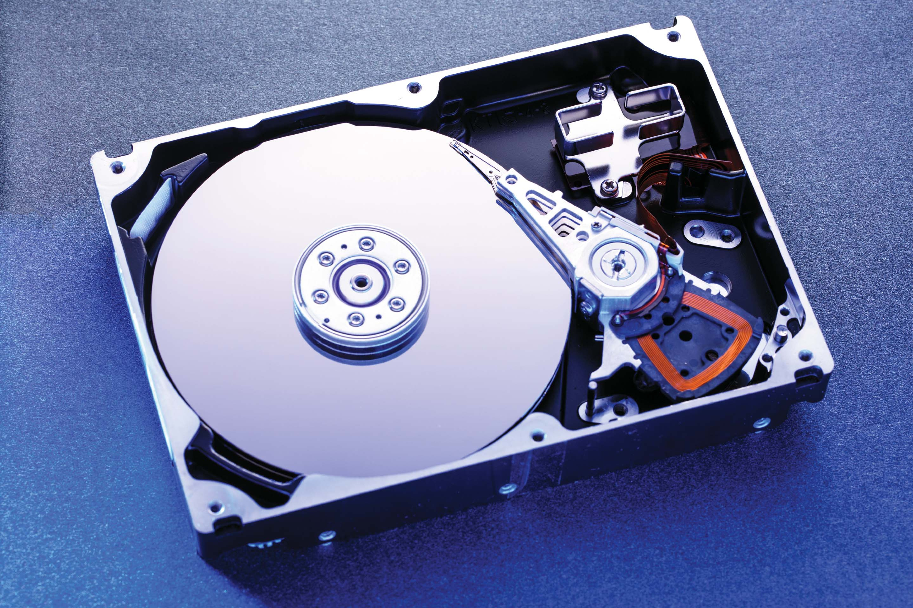
Hard Disk Drives

Slide 27
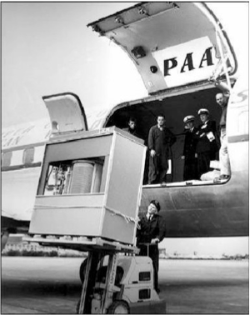
The First Commercial Disk Drive
1956
IBM RAMDAC computer included the IBM Model 350 disk storage system
5M (7 bit) characters
50 x 24” platters
Access time = < 1 second

Slide 28
HDD Scheduling
The operating system is responsible for using hardware efficiently — for the disk drives, this means having a fast access time and disk bandwidth
Minimize seek time
Seek time ≈ seek distance

Slide 29
Disk Scheduling (Cont.)
There are many sources of disk I/O request
OS
System processes
Users processes
I/O request includes input or output mode, disk address, memory address, number of sectors to transfer
OS maintains queue of requests, per disk or device
Idle disk can immediately work on I/O request, busy disk means work must queue
Optimization algorithms only make sense when a queue exists
In the past, operating system responsible for queue management, disk drive head scheduling
Now, built into the storage devices, controllers

Slide 30
Disk Scheduling (Cont.)
We illustrate scheduling algorithms with a request queue (0-199)
98, 183, 37, 122, 14, 124, 65, 67
Head pointer 53

Slide 31
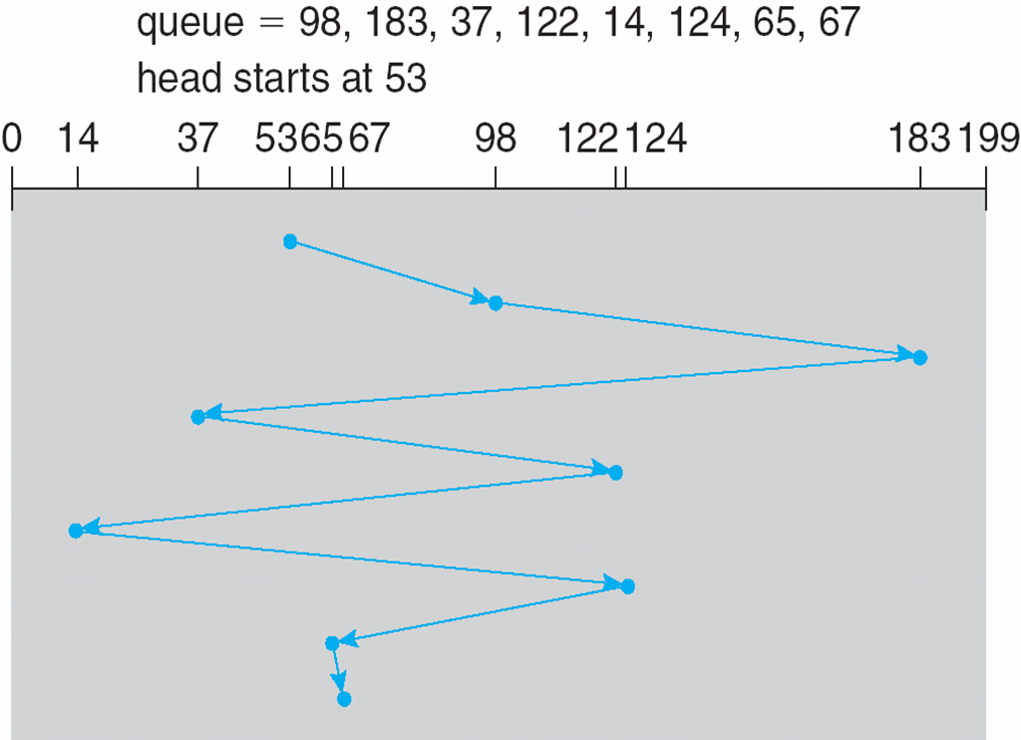
FCFS
Illustration shows total head movement of 640 cylinders

Slide 32
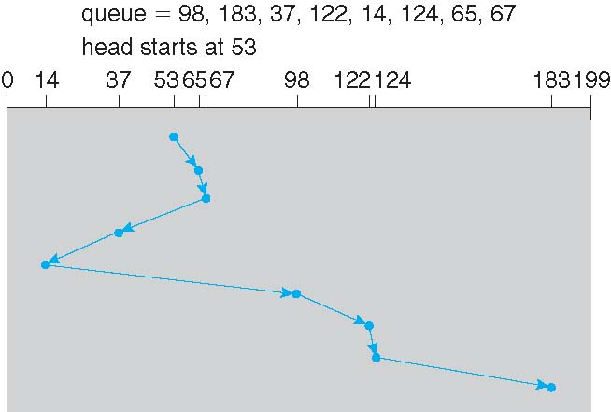
SSTF
Shortest Seek Time First selects the request with the minimum seek time from the current head position
SSTF scheduling is a form of SJF scheduling; may cause starvation of some requests
Illustration shows total head movement of 236 cylinders

Slide 33
SCAN
The disk arm starts at one end of the disk, and moves toward the other end, servicing requests until it gets to the other end of the disk, where the head movement is reversed and servicing continues.
SCAN algorithm Sometimes called the elevator algorithm
Illustration shows total head movement of 208 cylinders
But note that if requests are uniformly dense, largest density at other end of disk and those wait the longest

Slide 34
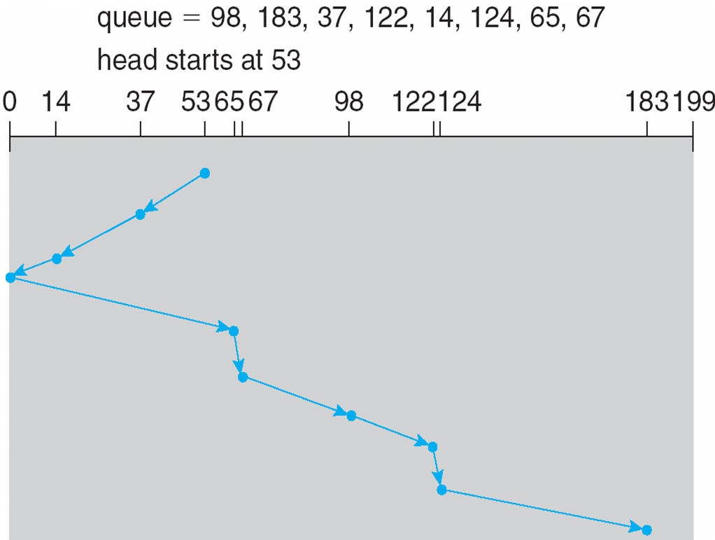
SCAN (Cont.)

Slide 35
C-SCAN
Provides a more uniform wait time than SCAN
The head moves from one end of the disk to the other, servicing requests as it goes
When it reaches the other end, however, it immediately returns to the beginning of the disk, without servicing any requests on the return trip
Treats the cylinders as a circular list that wraps around from the last cylinder to the first one
Total number of cylinders?

Slide 36
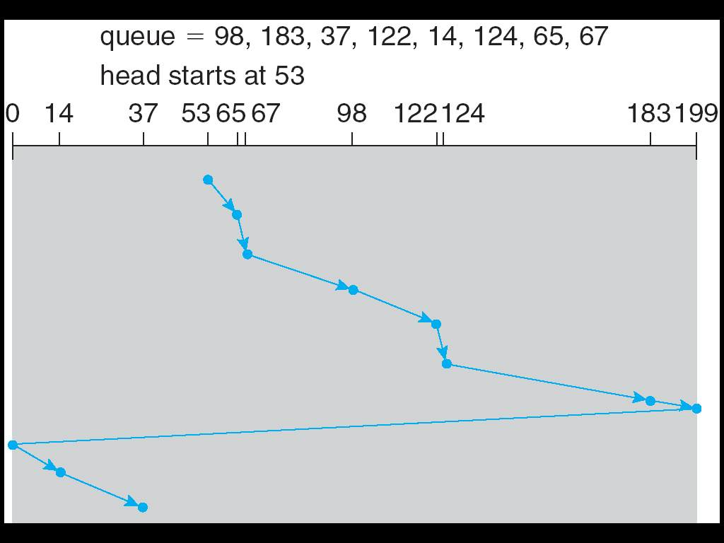
C-SCAN (Cont.)

Slide 37
Selecting a Disk-Scheduling Algorithm
SSTF is common and has a natural appeal
SCAN and C-SCAN perform better for systems that place a heavy load on the disk
Less starvation, but still possible
To avoid starvation Linux implements deadline scheduler
Maintains separate read and write queues, gives read priority
Because processes more likely to block on read than write

Slide 38
End of Chapter 7

